Slide 1
Switching course extra topics
Khaled Awdallah
CCIE#35993

Slide 2
Cisco Switches Models
We can divide Cisco switches into two main categories based on H/W as follows:
Modular Switches:
Catalyst 6500 Series.
Catalyst 4500 Series.
Nexus 7000 Series.
Fixed Configuration Switches:
Cisco Catalyst 4500-X Series
Cisco Catalyst 3750-X Series
Cisco Catalyst 3750-E Series
Many other series you can find it here.

Slide 3
Cisco Switches Models
Now the question is how could you choose the appropriate switch for your LAN which fits your network with minimum cost?
“Cisco Catalyst Switch Solution Finder” helps you to find what you need.
Also you can use “Cisco Feature Navigation” to select precisely the IOS which support features you need.
Also you can find all Cisco switches guide here.

Slide 4
Cisco Catalyst Switches

Slide 5
Cisco Catalyst Switches
We will talk here about 4 series of Cisco Catalyst switches and navigate some of its new H/W and S/W features:
Cisco Catalyst 3750 stackable switches.
Cisco Catalyst 4500-E switches.
Cisco Catalyst 6500 Switches.
Cisco Catalyst 6800 Switches.

Slide 6
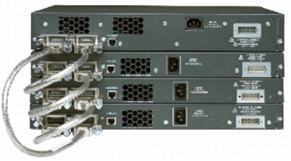
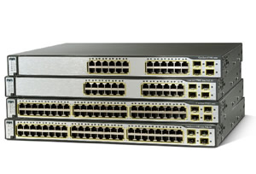
Cisco Catalyst Switches “3750 switches”
Cisco Catalyst 3750 series is a small to medium size switches.
Cat 3750 V2 switches is using Cisco EnergyWise technology which save more power and therefore reduce energy.
The most interesting feature of 3750 series is the Cisco StackWise feature and Cisco StackPower technology.
Cat 3750 family

Slide 7
Cisco Catalyst Switches “3750 switches”
LAB 1 StackWise & StackPower Technology
Let’s have here a small lab introducing the Cisco StackWise technology on Cisco 3750X and Cisco 2960S switches.
There are many helpful youtube videos to understand Cisco StackWise tech. and Cisco StackPower tech.
Refer to this web page to know the difference between StackWise and StackWisePlus.
Cisco 2960-S switches is using sub-technology from StackWisePlus called Cisco FlexStack , to know more about it and the difference between then, refer to this page.
Notes:
StackPower lab: PoD 3 has all stackpower cables are connected and working fine.

Slide 8
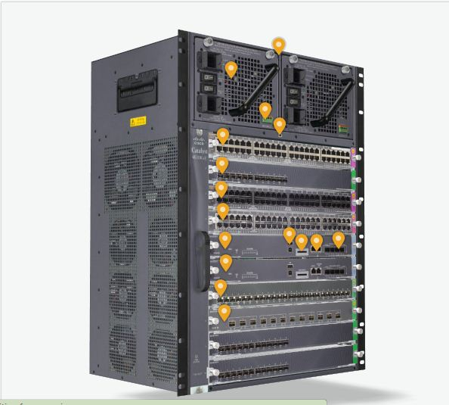
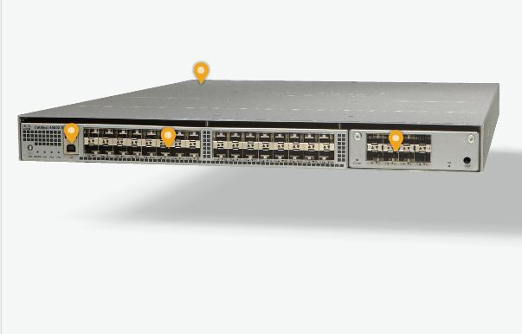
Cisco Catalyst Switches “4500 switches”
4500-X series
4500-E series
Notes:
StackPower lab: PoD 3 has all stackpower cables are connected and working fine.

Slide 9
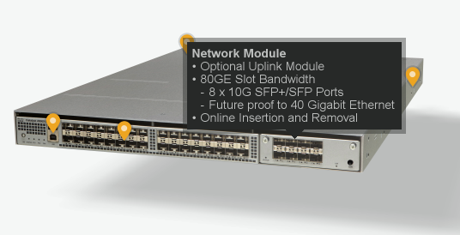
Cisco Catalyst Switches “4500 switches”
The 4500-X is a fixed configuration switch.
It is the bigger brother of 3750-X series as it is supports more features like VSS with forwarding speed of 1.6Tbps and with high performance of H/W based features.
Although it is a fixed configuration which means that its ports are fixed but it has a small module can be changed which supports the 10G interfaces.

Slide 10
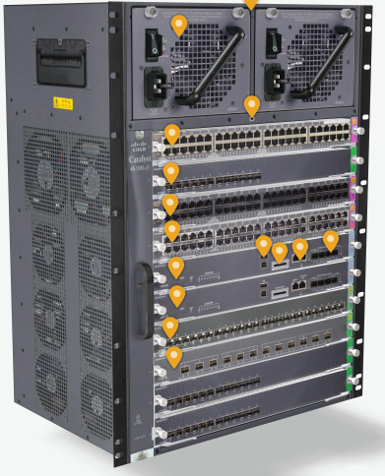
Cisco Catalyst Switches “4500 switches”
The 4500-E switch is a modular switch:
It supports up to 928Gbps switching capacity with the 8-E supervisor.
It is supports Cisco VSS technology for speed up to 1.8Tbps.
This switch is consists of many components:
Chassis
Dual Power Supply “use Cisco power calculator to know how much power do you need.
Fan Tray
Supervisor
Line Cards

Slide 11
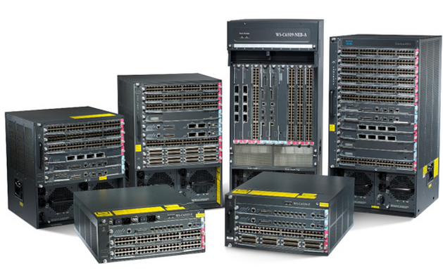
Cisco Catalyst Switches “6500 switches”
One of the most powerful Cisco LAN switches:
The most useful investment for the customers in LAN switching as Cisco claims that it may be useable till 2025 as per this report.
Physical H/W separation between Data Plane and Control Plane.
It can forward up to 2Tbps frames with the new Supervisor 2T.
Forwarding speed can be increased to be 4Tbps using Cisco VSS and it may be much larger in VSS Phase II.

Slide 12
Cisco Cat 6500 Switch IOS
Cisco 6500 switch was working using Cisco Cat-OS which was old OS used in Cat 6000 series.
Cat 6500 now is working using Cisco IOS which all Cisco engineers are familiar with.
It configuration is typically as all other Cisco Catalyst switches with some new features.
It was working on IOS 12.2 but now it supports IOS 15.0 which add many new features to it as VSS.

Slide 13
Cisco Cat 6500 Switch Models
It has many models:
6503-E
6504-E
6506-E
6509-E
6509-V-E
6513-E
It naming as 65xx where xx is the number of slots.
6509-V-E is a version of 6509-E but using vertical line cards and its air flow from front to back for customers who has a problem in right to left air flow in all other models.

Slide 14
Cisco Cat 6500 Switch component
It consists of many components:
Chassis
One of two power supply
Fan Tray
Supervisor
Line cards
Service Modules

Slide 15
Cisco Cat 6500 Switch component
Chassis: it has multiple chassis depending on the customer requirement.
Power supply: it can contain one or two power supplies in redundant mode or power-share mode.
Fan tray: is the fans card for each model, a single fan can’t be changed the full tray should be changed.
Line cards: many types of Line cards are supported covering all customer requirements.

Slide 16
Cisco Cat 6500 Switch component
Service Modules:
cards can be installed on 6500 switch to support certain functions.
It provide very high capability and functionality due to its application dedicated H/W.
There are many modules for different security features, network analysis and wireless services.
Here you can find all types of supported service modules.

Slide 17
Cisco Cat 6500 Switch component
Supervisor:
It is the main component of modular switches.
It is the processing card of the switch which play the control plane role and controls the forwarding plan.
There are many types of supervisors depending on its speed.
The latest one is the SUP-2T which supports 2Tbps forwarding speed in full-duplex mode.
All 6500 switch models support up two SUP-2T

Slide 18
Cisco Cat 6500 Switch SUP-2T
SUP-2T supports many new features:
VSS support up to 4Tbps forwarding speed.
A configurable Out Of Band Configuration management port (CMP) for remote access the switch in case of supervisor Route Processor failure.
It contains daughter card called MSFCv5 which is responsible of control plane processing for the whole switch.
It also contains another daughter card called PFC4 which is responsible for all forwarding plane and other features line L2 rewrite and ACL apply.
It support Line cards with DFC4 for maximum forwarding speed.

Slide 19
Cisco Nexus Switches

Slide 20
Cisco Nexus switches
Data centers was supported by Cisco 6500 switches.
Cisco Nexus switches is a new series of switches that made specially for Data Centers.
It provides many features that are very useful for Data Centers and port density and forwarding speed that are suitable for large data centers.
It has many models that fits all data centers sizes.

Slide 21
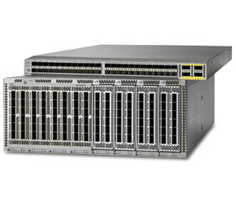
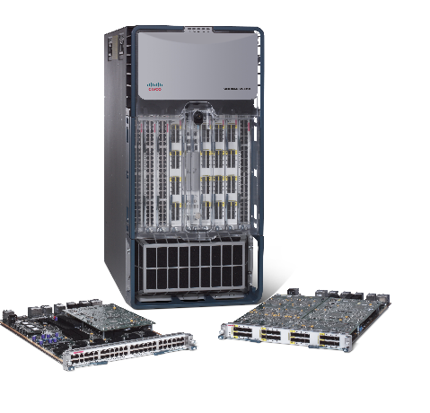
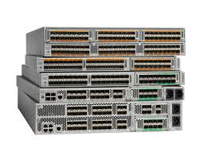
Cisco Nexus switches

Slide 22
Cisco Nexus switches IOS
Cisco Nexus switches use the Cisco NX-OS which much like the normal IOS but with some differences that accommodates with data centers nature.

